Slide 1
Advanced Computer Architecture
Hwang, Chapter 7
Multiprocessors and Multicomputers
7.2 Cache Coherence & Synchronization

Slide 2
The Cache Coherence Problem
Since there are multiple levels in a memory hierarchy, with some of these levels private to one or more processors, some levels may contain copies of data objects that are inconsistent with others.
This problem is manifested most obviously when individual processors maintain cached copies of a unique shared-memory location, and then modify that copy. The inconsistent view of that object obtained from other processor’s caches and main memory is called the cache coherence problem.

Slide 3

Causes of Cache Inconsistency
Cache inconsistency only occurs when there are multiple caches capable of storing (potentially modified) copies of the same objects.
There are three frequent sources of this problem:
  Sharing of writable data
  Process migration
  I/O activity

Slide 4
Inconsistency in Data Sharing
Suppose two processors each use (read) a data item X from a shared memory. Then each processor’s cache will have a copy of X that is consistent with the shared memory copy.
Now suppose one processor modifies X (to X’). Now that processor’s cache is inconsistent with the other processor’s cache and the shared memory.
With a write-through cache, the shared memory copy will be made consistent, but the other processor still has an inconsistent value (X).
With a write-back cache, the shared memory copy will be updated eventually, when the block containing X (actually X’) is replaced or invalidated.

Slide 5
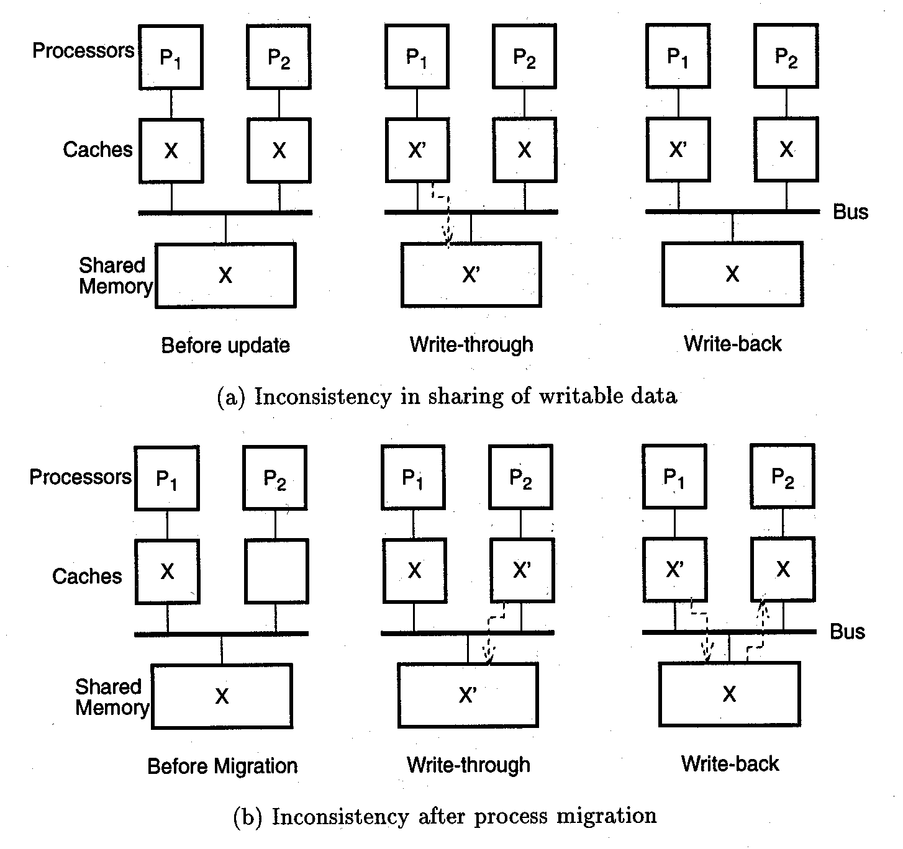
Inconsistency in Data Sharing

Slide 6
Inconsistency After Process Migration
If a process accesses variable X (resulting in it being placed in the processor cache), and is then moved to a different processor and modifies X (to X’), then the caches on the two processors are inconsistent.
This problem exists regardless of whether write-through caches or write-back caches are used.

Slide 7
Inconsistency after Process Migration

Slide 8
Inconsistency Caused by I/O
Data movement from an I/O device to a shared primary memory usually does not cause cached copies of data to be updated.
As a result, an input operation that writes X causes it to become inconsistent with a cached value of X.
Likewise, writing data to an I/O device usually use the data in the shared primary memory, ignoring any potential cached data with different values.
A potential solution to this problem is to require the I/O processors to maintain consistency with at least one of the processor’s private caches, thus “passing the buck” to the processor cache coherence solution (which will we see).

Slide 9
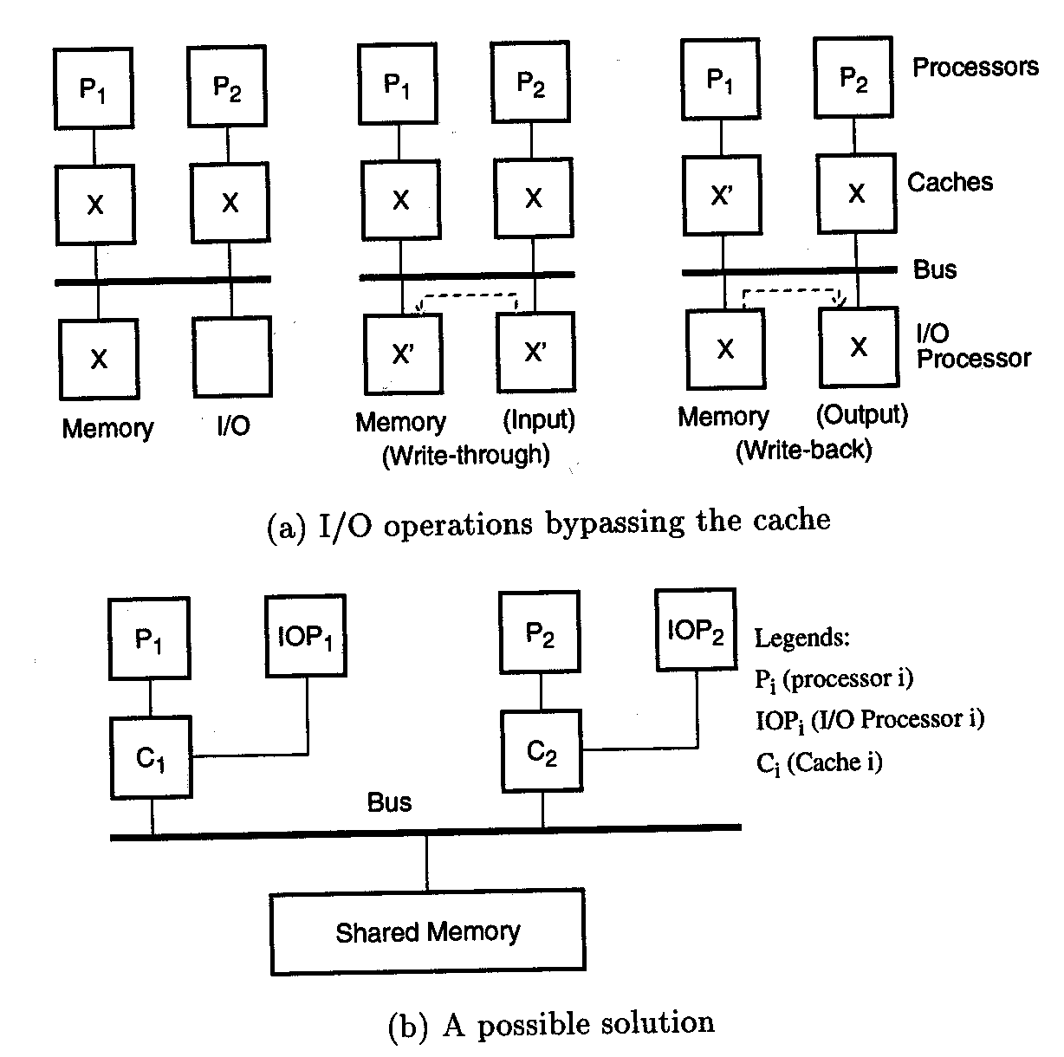
I/O Operations Bypassing the Cache

Slide 10
A Possible Solution

Slide 11
Cache Coherence Protocols
When a bus is used to connect processors and memories in a multiprocessor system, each cache controller can “snoop” on all bus transactions, whether they involve the current processor or not. If a bus transaction affects the consistency of a locally-cached object, then the local copy can be invalidated.
If a bus is not used (e.g. a crossbar switch or network is used), then there is no convenient way to “snoop” on memory transactions. In these systems, some variant of a directory scheme is used to insure cache coherence.

Slide 12
Snoopy Bus Protocols
Two basic approaches
  write-invalidate – invalidate all other cached copies of a data object when the local cached copy is modified (invalidated items are sometimes called “dirty”)
  write-update – broadcast a modified value of a data object to all other caches at the time of modification
Snoopy bus protocols achieve consistency among caches and shared primary memory by requiring the bus interfaces of processors to watch the bus for indications that require updating or invalidating locally cached objects.

Slide 13
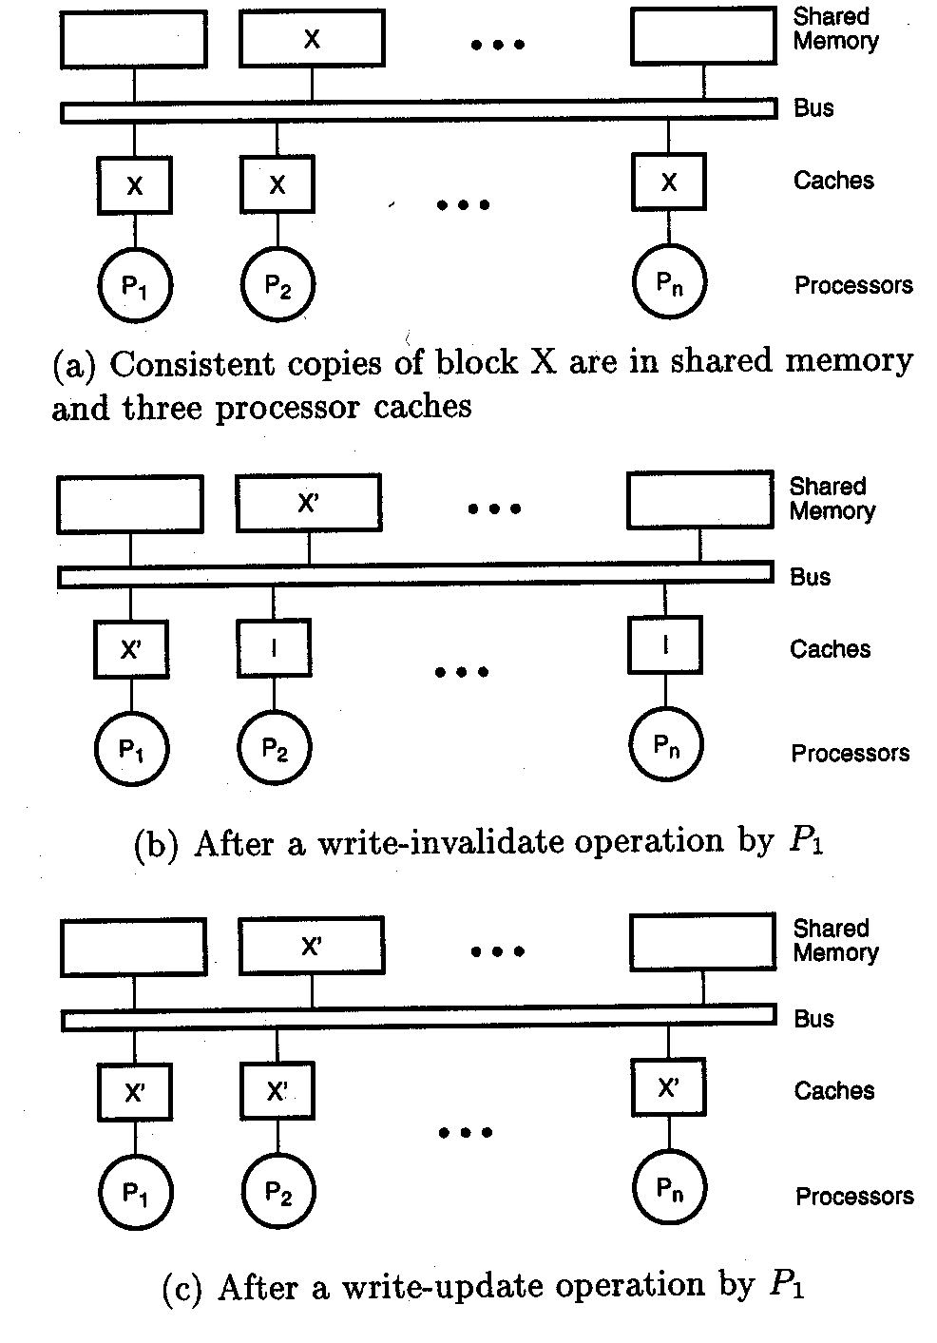
Initial State – Consistent Caches

Slide 14
After Write-Invalidate by P₁

Slide 15
After Write-Update by P₁

Slide 16
Operations on Cached Objects
Read – as long as an object has not been invalidated, read operations are permitted, and obviously do not change the object’s state
Write – as long as an object has not been invalidated, write operations on the local object are permitted, but trigger the appropriate protocol action(s).
Replace –the cache block containing an object is replaced (by a different block)

Slide 17
Write-Through Cache
In the transition diagram (next slide), the two possible object states in the “local” cache (valid and invalid) are shown.
The operations that may be performed are read, write, and replace by the local processor or a remote processor.
Transitions from locally valid to locally invalid occur as a result of a remote processor write or a local processor replacing the cache block.
Transitions from locally invalid to locally valid occur as a result of the local processor reading or writing the object (necessitating, of course, the fetch of a consistent copy from shared memory).

Slide 18
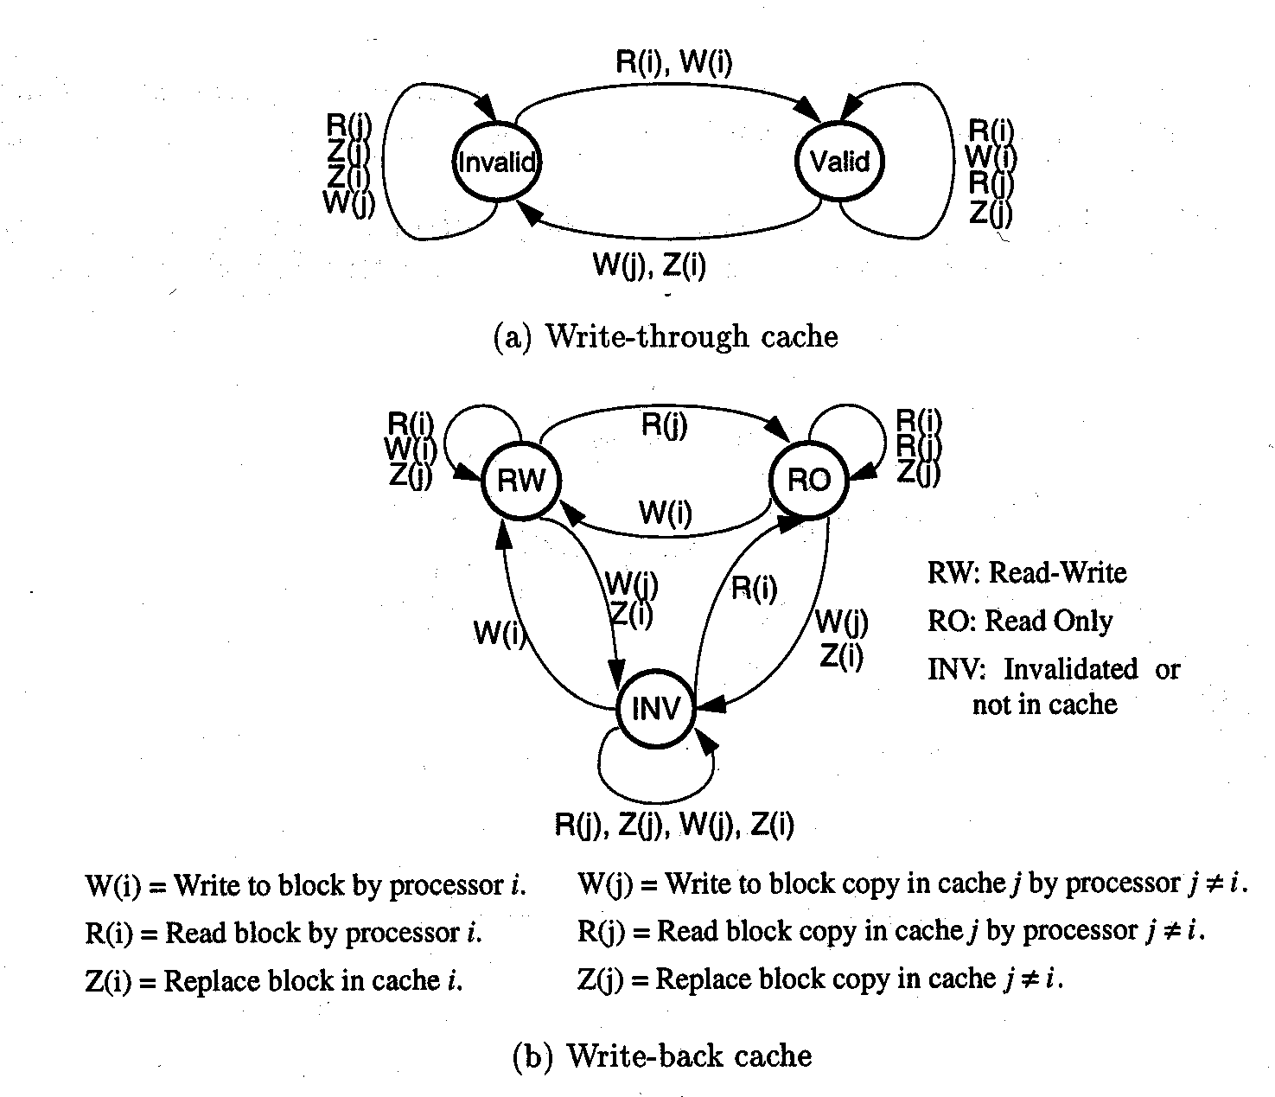
Write-Through Cache State Transitions
R = Read, W = Write, Z = Replace
i = local processor, j = other processor

Slide 19
Write-Back Cache
The state diagram for the write-back protocol divides the valid state into RW and RO states.
The protocol essentially gives “ownership” of the cache block containing the object to a processor when it does a write operation.
Before an object can be modified, ownership for exclusive access must first be obtained by a read-only bus transaction which is broadcast to all caches and memory.
If a modified block copy exists in a remote cache, memory must first be updated, the copy invalidated, and ownership transferred to the requesting cache.

Slide 20
Write-Back Cache

Slide 21
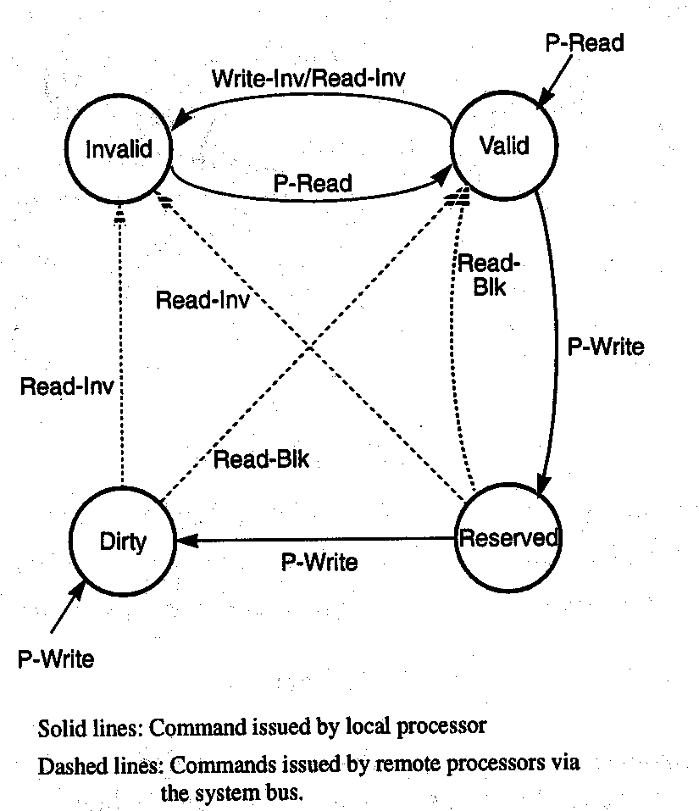
Goodman’s Write-Once Protocol State Diagram

Slide 22

Goodman’s Cache Coherence Protocol
Combines advantages of write-back and write-through protocols.
First write of a cache block uses write-through.
Cache states (see previous slide):
  Valid: block is consistent with memory, has been read, but not modified.
  Invalid: block not in cache, or is inconsistent with memory.
  Reserved: block written once after being read and is consistent with memory copy (which is the only other copy).
  Dirty: block modified more than once, inconsistent with all other copies.

Slide 23
Commands and State Transitions
Local processor accesses:
  Read-hit or read-miss (P-Read) – transition to valid state.
  Write-hit (P-Write)
    First one results in transition to reserved state.
    Additional writes go to (or stay in) dirty state.
  Write-miss – transition to dirty state.
Remote processor invalidation commands (issued over snoopy bus):
  Read-invalidate – read a block and invalidate all other copies.
  Write-invalidate – invalidate all other copies of a block.
  Bus-read (Read-blk) – normal read; transition to valid state.
(Note textbook correction.)

Slide 24
Snoopy Bus Protocol Performance
Depends heavily on the workload.
In uniprocessors:
  bus traffic and memory-access time heavily influenced by cache misses.
  Miss ratio increases as block size increases, up to a data pollution point (that is, as blocks become larger, the probability of finding a desired data item in the cache increases).
  Data pollution point increases with larger cache sizes.

Slide 25
Snoopy Bus Protocol Performance
In multiprocessor systems
  Write-invalidate protocol
    Better handles process migrations and synchronization than other protocols.
    Cache misses can result from invalidations sent by other processors before a cache access, which significantly increases bus traffic.
    Bus traffic may increase as block sizes increase.
    Write-invalidate facilities writing synchronization primitives.
    Average number of invalidated cache copies is small in a small multiprocessor.
  Write-update procotol
    Requires bus broadcast facility
    May update remote cached data that is never accessed again
    Can avoid the back and forth effect of the write-invalidate protocol for data shared among multiple caches
    Can’t be used with long write bursts
    Requires extensive tracing to identify actual behavior

Slide 26
Directory-based Protocols
The snoopy bus-based protocols may be adequate for relatively small multiprocessor systems, but are wholly inadequate for large multiprocessor systems.
Commands (in the form of messages) to control the consistency of remote caches must be sent only to those processors with caches containing a copy of the affected block (since broadcast is very expensive in a multistage network – like Omega).
This gives rise to directory-based protocols.

Slide 27
Directory Structures
Cache directories store information on where (in which processors) copies of cache blocks reside.
Central directory approaches (with copies of all cache directories) is very large, and requires an associative search (like the individual cache directories).
Memory modules might keep track of which processor caches have copies of their data, thus allowing the memory module to redirect cache miss requests to the cache that contains the “dirty” data (causing the associated writing of the block to memory).

Slide 28
Types of Directory Protocols
Directory entries are pairs identifying cache blocks and processor caches holding those blocks.
Three different types of directory protocols:
  Full-map directories – each directory entry can identify all processors with cached copies of data; with N processors, each directory entry must have N processor ID identifiers.
  Limited directories – each entry has a fixed number of processor identifiers, regardless of the system size.
  Chained directories – emulate full-map directories by distributing entries among the caches.

Slide 29
Full-map Protocols
Directory entries have one bit per processor in the system, and another bit to indicate if the data has been modified (“dirty”).
If the dirty bit is set, then only one processor must be identified in the bit map; only that processor is allowed to write the block into memory.
Cache maintains two bits of state information per block:
  Is the cached block valid?
  Can a valid cached block be written to memory?
The purpose of the cache coherence protocol is to keep the cache’s state bits and those in the memory directory consistent.

Slide 30
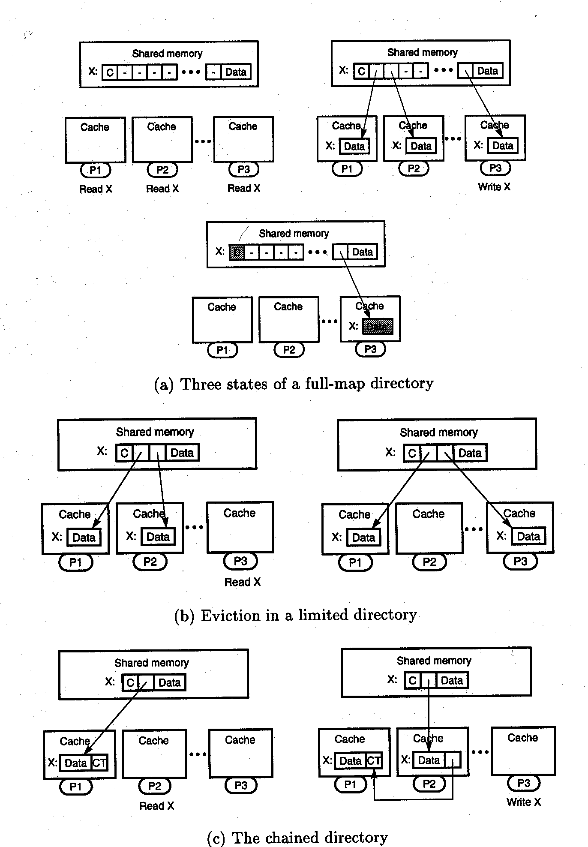
Three States of a Full-Map Directory

Slide 31
Full Map State Changes
In the first state (upper left in previous slide), X is missing from all caches.
In the second state, three caches are requesting copies of X. The bits of the three processors are set, and the dirty bit is still ‘C’ (clean), since no processor has requested to write X.
In the third state, the dirty bit is set (‘D’), since a processor requested to write X. Only the corresponding processor has it’s bit set in the map.

Slide 32
Write Actions
Cache C3 detects the block is valid, but the processor doesn’t have write permission.
Write request issued to memory, stalling the processor.
Other caches receive invalidate requests and send acknowledgements to memory.
Memory receives acknowledgements, sets dirty bit, clears pointers to other processors, sends write permission to C3.
  By waiting for acknowledgements, the memory ensures sequential consistency.
C3 gets write permission, updates cache state, and reactivates the processor.

Slide 33
Full-Map Protocol Benefits
The full-map protocol provides an upper bound on the performance of centralized directory-based cache coherence.
It is not scalable, however, because of the excessive memory overhead it incurs.

Slide 34
Limited Directories
Designed to solve the directory size problem.
Restricts the number of cached copies of a datum, thus limiting the growth of the directory.
Agrawal notation: Dir_{i} X
  i indicates number of pointers in directory
  X is NB for no broadcast, B for broadcast
  E.g. full map with N processors is Dir_{N} NB
In the example (next slide), the left figure shows C1 and C2 holding copies of X. When C3 requests a copy, the C1 or C2 copy must be invalidated using a process called “eviction,” as shown by the right figure.

Slide 35
Eviction in a Limited Directory

Slide 36
Limited Directory Memory Size
In the full-map protocol, it is sufficient to use a single bit to identify if each of the N processors has a copy of the datum.
In a limited directory scheme, processor numbers must be maintained, requiring log₂ N bits each.
If the code being executed on a multiprocessor system exhibits “processor locality,” then a limited directory is sufficient to capture the identity of the processors.

Slide 37
Limited Directory Scalability
Limited directory schemes for cache coherency in non-bus systems are scalable, in that the number of resources required for their implementation grows linearly as the number of processors grows.
Dir_{i} B protocols exist that allow more than i copies of a block to exist in caches, but must use broadcast to invalidate more than i copies of a block (because of a write request). Without a broadcast capability in the connection network, ensuring sequential consistency is difficult.

Slide 38
Chained Directories
Chained directories are scalable (like limited directories).
They keep track of shared copies of data using a chain of directory pointers.
Each cache must include a pointer (which can be the chain termination pointer) to the next cache that contains a datum.
When a processor requests a read, it is sent the datum along with a pointer to the previous head of the list (or a chain termination pointer if it is the only processor requesting the datum).

Slide 39
A Chained Directory Example

Slide 40
Invalidation in Chained Directories
When a processor requests to write a datum, the processor at the head of the list is sent an invalidate request.
Processors pass the invalidate request along until it reaches the processor at the end of the list.
That processor sends an acknowledgement to the memory, which then grants write access to the processor requesting such.
Author suggests this be called the “gossip” protocol.

Slide 41
Complications with Chained Dirs
Suppose processor i requests Y, and the (direct-mapped) cache already contains an entry X which maps to the same location as Y. It must evict X from its cache, thus requiring the list of X’s users to be altered.
Two schemes for the list alteration:
  Send a message “down the list” to cache i-1 with a pointer to cache i+1, removing i from the list.
  Invalidate X in caches i+1 through N.
Alternately, a doubly-linked list could be used, with the expected implications for size, speed, and protocol complexity.
Chained directories are scalable, and cache sizes (not number of processors) control the number of pointers.

Slide 42
Alternative Coherency Schemes
Shared caches – allow groups of processors to share caches. Within the group, the coherency problem disappears. Many configurations are possible.
Identify noncacheable data – have the software mark data (using hardware tags) that can be shared (e.g. not instructions or private data), and disallow caching of these.
Flush caches at synchronization – force a rewrite of cached data each time synchronization, I/O, or process migration might affect any of the cached data. Usually this is slow.

Slide 43
Hardware Synchronization Methods
Test and set – TS instruction atomically writes 1 to a memory location and returns its previous value (0 if the controlled resource is free). All processors attempting TS on same location except one will get 1, with one processor getting zero. The “spin lock” is cleared by writing 0 to the location.
Suspend lock – a lock is designed to generate an interrupt when it is released (opened). A process wanting the lock (but finding it closed) will disable disable all interrupts except that associated with the lock and wait.

Slide 44
Wired Barrier Synchronization
Barriers are used to block a set of processes until each reaches the same code point.
This scheme uses a wire which is “1” unless one of the processors sets its X bit, which forces the wire to “0”. The X bit is set when a process has not yet reached the barrier.
As each process reaches the barrier, it clears its X bit and waits for the Y bit to become “1”; the Y bit reports the state of the wire.

Slide 45
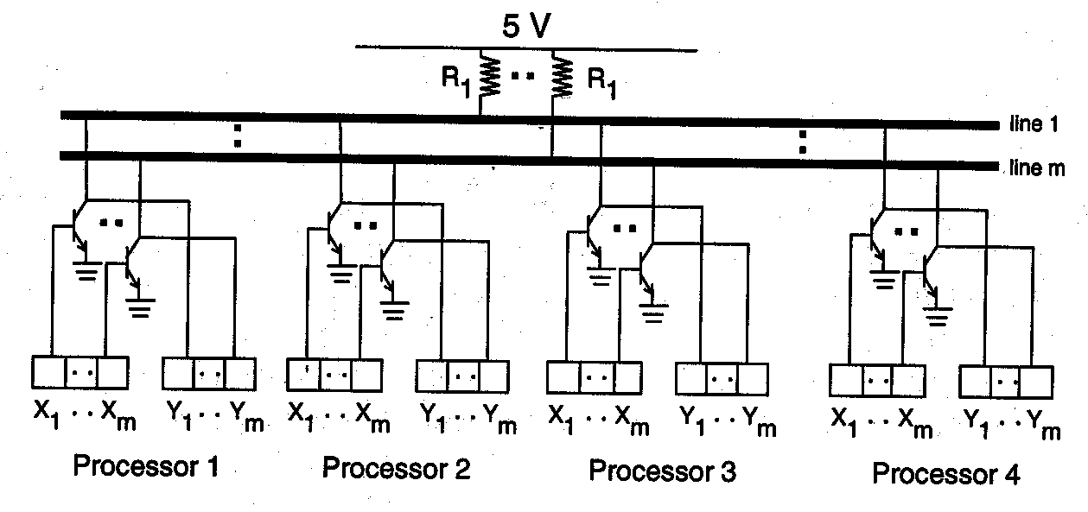
Wired Barrier Implementation

Slide 46
Wired Barrier Example
fork
X₁ ← 1
X₂ ← 1
work
work
X₁ ← 0
X₂ ← 0
No
No
Y₁ = 1?
Y₂ = 1?
Yes
Yes

